Slide 1
Quantum computing
Vu Tuan Hai

Slide 2
Learning objects
Basis linear algebra (vector, matrix)
Qubit, superposition, quantum logic gate

Slide 3
Concept
From deterministic to non-deterministic
From certainly to uncertainty
From local to non-local

Slide 4

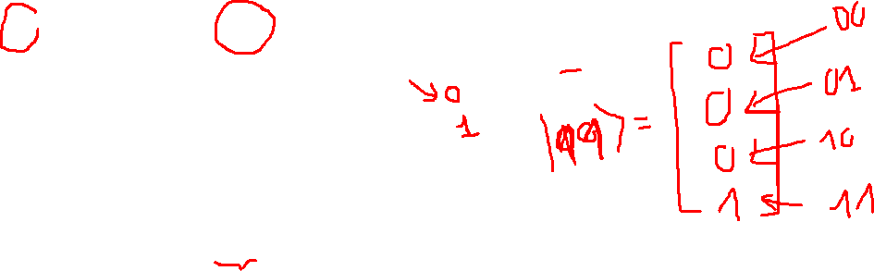
1. Basis linear algebra
Bit with value 0, is written as $|0⟩$ (Dirac vector notation)
$$\left|0\right\rangle =\left[\begin{matrix}1 \\ 0\end{matrix}\right]$$
Bit with value 1, is written as $|1⟩$ (Dirac vector notation)
$$\left|1\right\rangle =\left[\begin{matrix}0 \\ 1\end{matrix}\right]$$

Slide 5
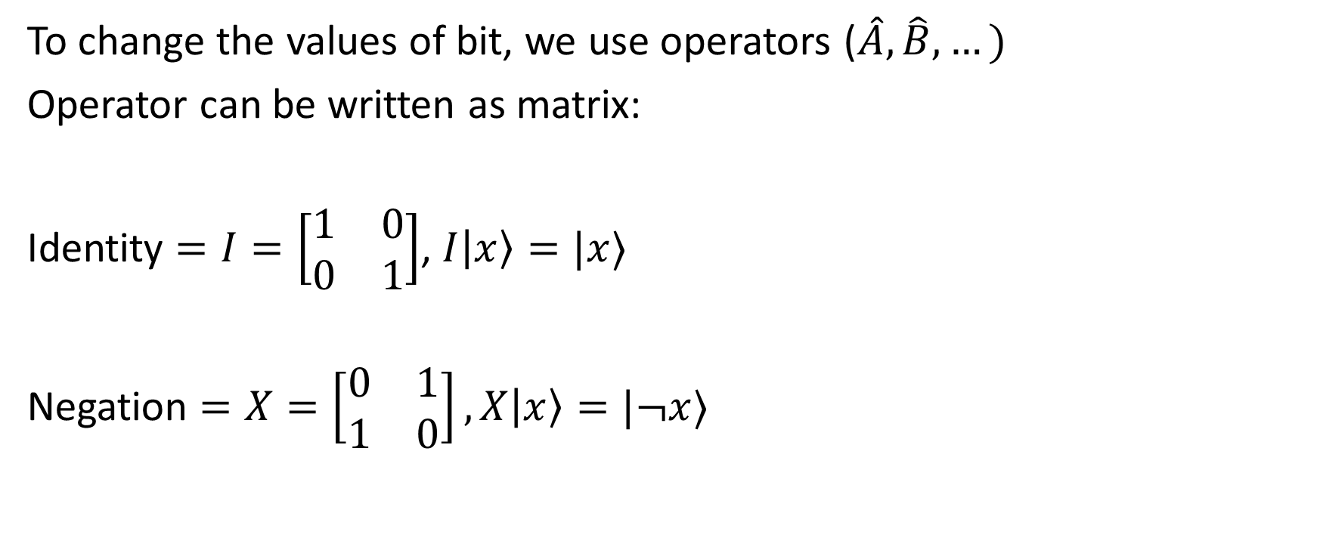
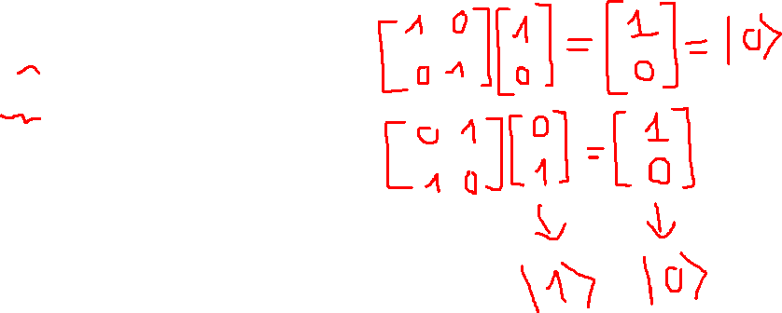
1. Basis linear algebra
To change the values of bit, we use operators ($\hat{A},\hat{B},…)$
Operator can be written as matrix:
Identity $=I=\left[\begin{matrix}1 & 0 \\ 0 & 1\end{matrix}\right]$, $I\left|x\right\rangle =|x⟩$
Negation $=X=\left[\begin{matrix}0 & 1 \\ 1 & 0\end{matrix}\right], X\left|x\right\rangle =|¬x⟩$

Slide 6
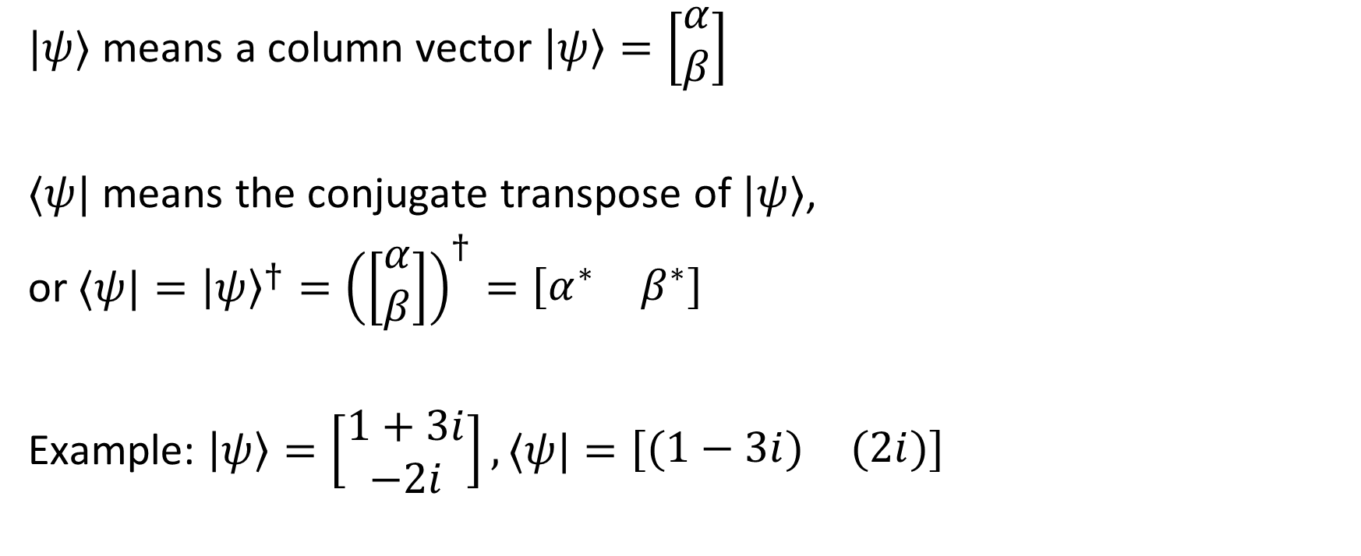

1. Basis linear algebra: bra-ket notation
$|ψ⟩$ means a column vector $\left|ψ\right\rangle =\left[\begin{matrix}α \\ β\end{matrix}\right]$
$⟨ψ|$ means the conjugate transpose of $|ψ⟩$,
or $⟨ψ|={\left|ψ\right\rangle }^{†}={\left(\left[\begin{matrix}α \\ β\end{matrix}\right]\right)}^{†}=\left[\begin{matrix}α^{∗} & β^{∗}\end{matrix}\right]$
Example: $\left|ψ\right\rangle =\left[\begin{matrix}1+3i \\ −2i\end{matrix}\right],⟨ψ|=\left[\begin{matrix}(1−3i) & (2i)\end{matrix}\right]$

Slide 7
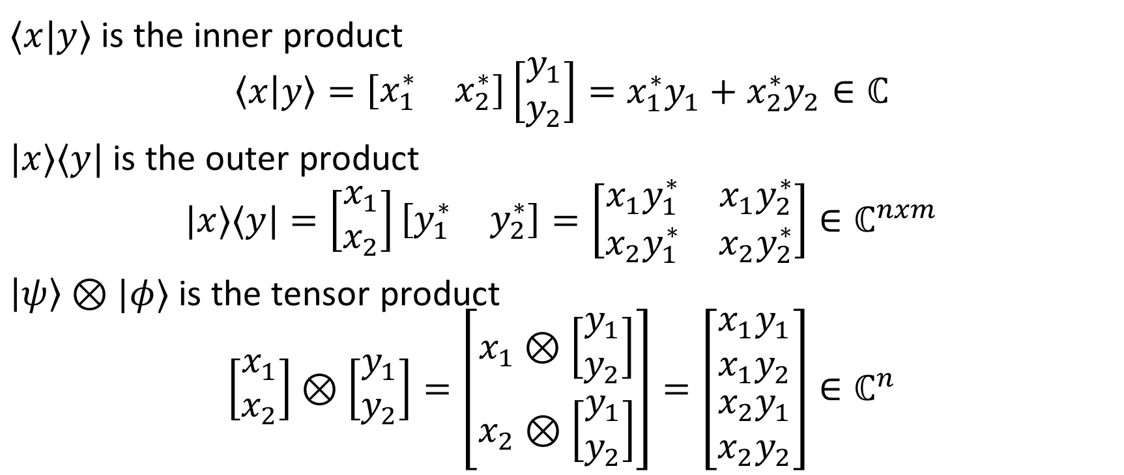
1. Basis linear algebra: bra-ket notation
$⟨x|y⟩$ is the inner product
$$\left\langle x | y\right\rangle =\left[\begin{matrix}x_{1}^{∗} & x_{2}^{∗}\end{matrix}\right]\left[\begin{matrix}y_{1} \\ y_{2}\end{matrix}\right]=x_{1}^{∗}y_{1}+x_{2}^{∗}y_{2}∈ℂ$$
$|x⟩⟨y|$ is the outer product
$$|x⟩⟨y|=\left[\begin{matrix}x_{1} \\ x_{2}\end{matrix}\right]\left[\begin{matrix}y_{1}^{∗} & y_{2}^{∗}\end{matrix}\right]=\left[\begin{matrix}x_{1}y_{1}^{∗} & x_{1}y_{2}^{∗} \\ x_{2}y_{1}^{∗} & x_{2}y_{2}^{∗}\end{matrix}\right]∈ℂ^{nxm}$$
$\left|ψ\right\rangle ⊗|φ⟩$ is the tensor product
$$\left[\begin{matrix}x_{1} \\ x_{2}\end{matrix}\right]⊗\left[\begin{matrix}y_{1} \\ y_{2}\end{matrix}\right]=\left[\begin{matrix}x_{1}⊗\left[\begin{matrix}y_{1} \\ y_{2}\end{matrix}\right] \\ x_{2}⊗\left[\begin{matrix}y_{1} \\ y_{2}\end{matrix}\right]\end{matrix}\right]=\left[\begin{matrix}\begin{matrix}x_{1}y_{1} \\ x_{1}y_{2}\end{matrix} \\ x_{2}y_{1} \\ x_{2}y_{2}\end{matrix}\right]∈ℂ^{n}$$

Slide 8
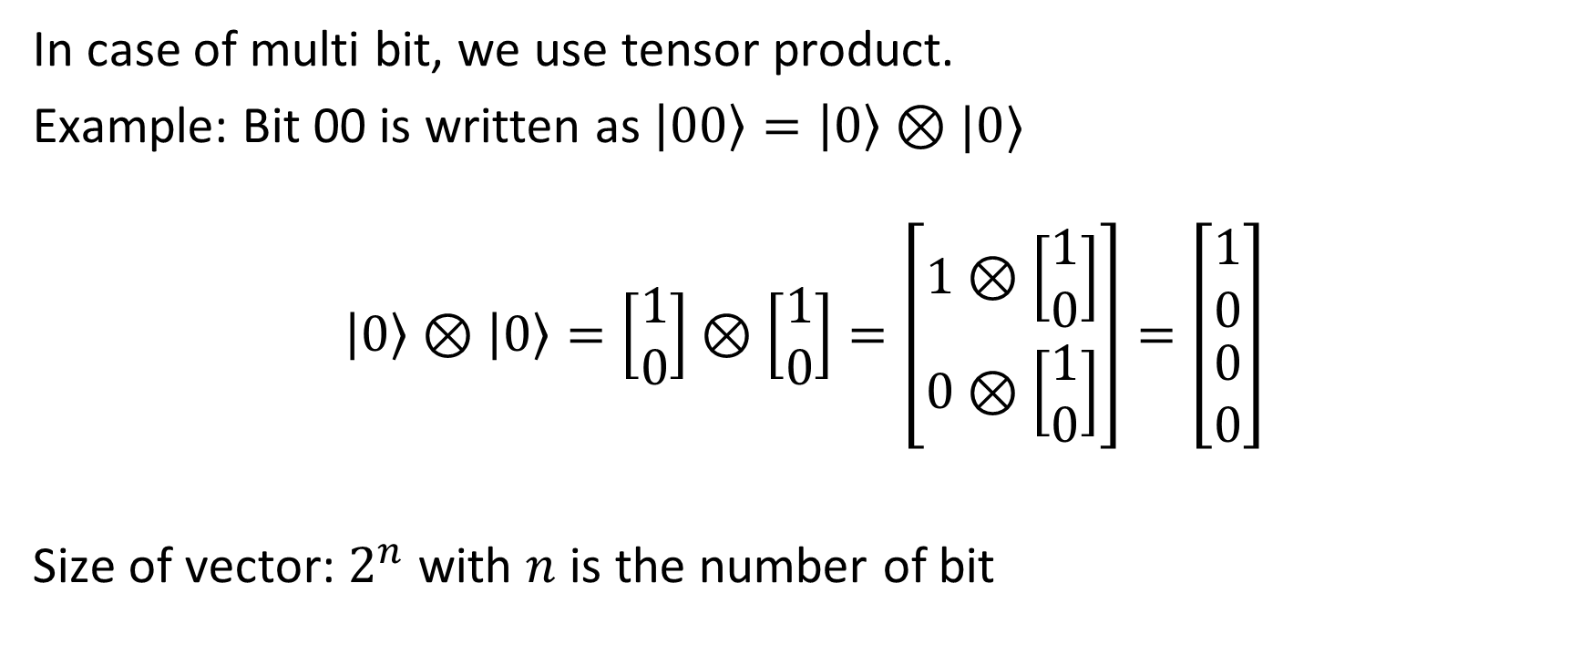
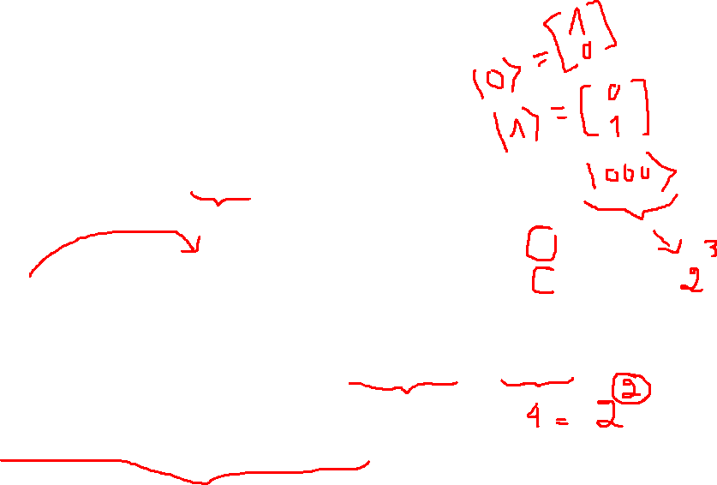
1. Basis linear algebra: multi-bit
In case of multi bit, we use tensor product.
Example: Bit 00 is written as $\left|00\right\rangle =\left|0\right\rangle ⊗|0⟩$
$$\left|0\right\rangle ⊗\left|0\right\rangle =\left[\begin{matrix}1 \\ 0\end{matrix}\right]⊗\left[\begin{matrix}1 \\ 0\end{matrix}\right]=\left[\begin{matrix}1⊗\left[\begin{matrix}1 \\ 0\end{matrix}\right] \\ 0⊗\left[\begin{matrix}1 \\ 0\end{matrix}\right]\end{matrix}\right]=\left[\begin{matrix}\begin{matrix}1 \\ 0\end{matrix} \\ 0 \\ 0\end{matrix}\right]$$
Size of vector: $2^{n}$ with $n$ is the number of bit

Slide 9
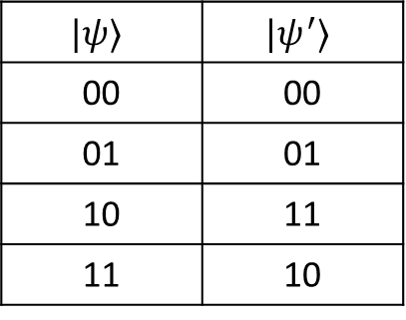
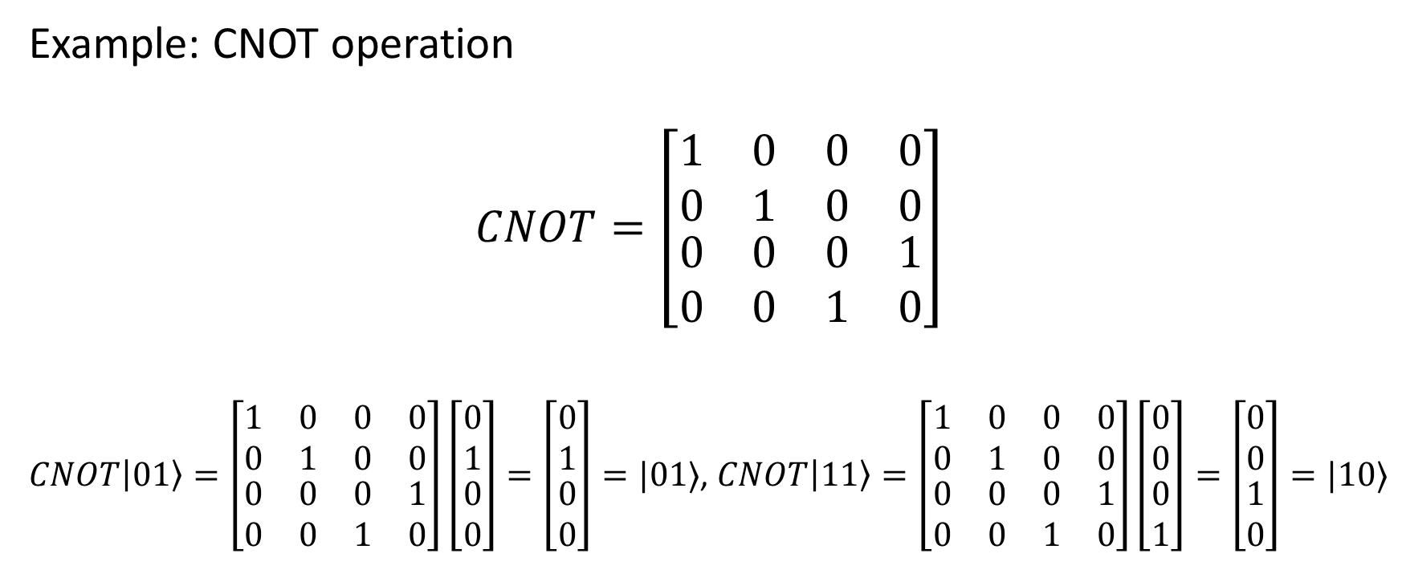
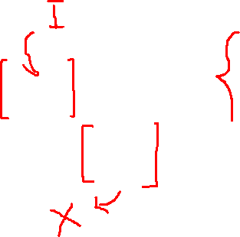
1. Basis linear algebra: operation on multi-bit
Example: CNOT operation
$$CNOT=\left[\begin{matrix}\begin{matrix}1 & 0 \\ 0 & 1\end{matrix} & \begin{matrix}0 & 0 \\ 0 & 0\end{matrix} \\ \begin{matrix}0 & 0 \\ 0 & 0\end{matrix} & \begin{matrix}0 & 1 \\ 1 & 0\end{matrix}\end{matrix}\right]$$
$CNOT\left|01\right\rangle =\left[\begin{matrix}\begin{matrix}1 & 0 \\ 0 & 1\end{matrix} & \begin{matrix}0 & 0 \\ 0 & 0\end{matrix} \\ \begin{matrix}0 & 0 \\ 0 & 0\end{matrix} & \begin{matrix}0 & 1 \\ 1 & 0\end{matrix}\end{matrix}\right]\left[\begin{matrix}\begin{matrix}0 \\ 1\end{matrix} \\ 0 \\ 0\end{matrix}\right]=\left[\begin{matrix}\begin{matrix}0 \\ 1\end{matrix} \\ 0 \\ 0\end{matrix}\right]=|01⟩$, $CNOT\left|11\right\rangle =\left[\begin{matrix}\begin{matrix}1 & 0 \\ 0 & 1\end{matrix} & \begin{matrix}0 & 0 \\ 0 & 0\end{matrix} \\ \begin{matrix}0 & 0 \\ 0 & 0\end{matrix} & \begin{matrix}0 & 1 \\ 1 & 0\end{matrix}\end{matrix}\right]\left[\begin{matrix}\begin{matrix}0 \\ 0\end{matrix} \\ 0 \\ 1\end{matrix}\right]=\left[\begin{matrix}\begin{matrix}0 \\ 0\end{matrix} \\ 1 \\ 0\end{matrix}\right]=|10⟩$
$$|ψ⟩$$ | $$|ψ^{′}⟩$$
00 | 00
01 | 01
10 | 11
11 | 10

Slide 10
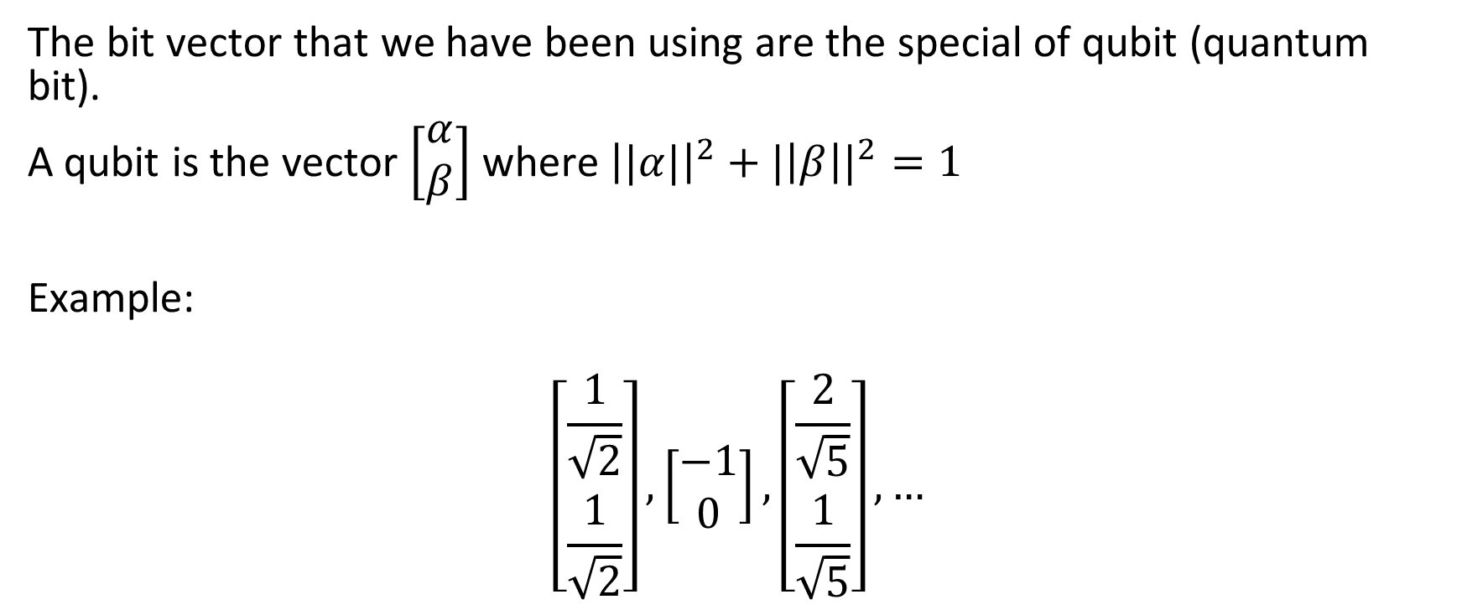
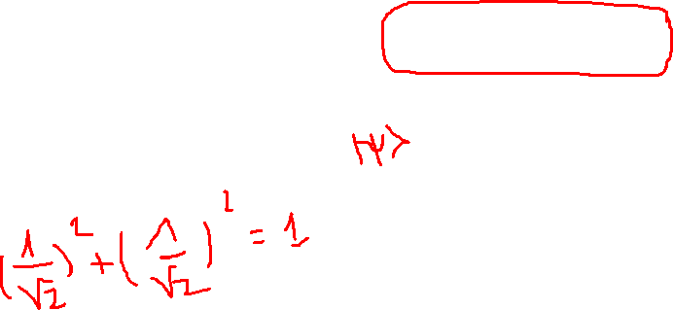
2. Qubit, superposition
The bit vector that we have been using are the special of qubit (quantum bit).
A qubit is the vector $\left[\begin{matrix}α \\ β\end{matrix}\right]$ where ${\left||α|\right|}^{2}+{|\left|β\right||}^{2}=1$
Example:
$$\left[\begin{matrix}\frac{1}{\sqrt{2}} \\ \frac{1}{\sqrt{2}}\end{matrix}\right],\left[\begin{matrix}−1 \\ 0\end{matrix}\right],\left[\begin{matrix}\frac{2}{\sqrt{5}} \\ \frac{1}{\sqrt{5}}\end{matrix}\right],…$$

Slide 11

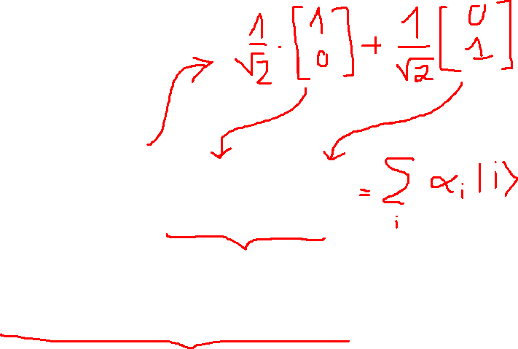
2. Qubit, superposition
What’s it means?
$$\left|ψ\right\rangle =\left[\begin{matrix}\frac{1}{\sqrt{2}} \\ \frac{1}{\sqrt{2}}\end{matrix}\right]=\frac{1}{\sqrt{2}}\left|0\right\rangle +\frac{1}{\sqrt{2}}|1⟩$$
It’s means this qubit is both $|0⟩$ and $|1⟩$ at the same time

Slide 12
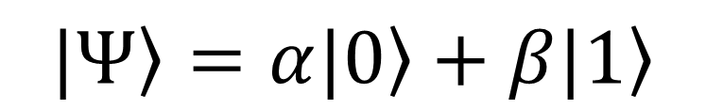
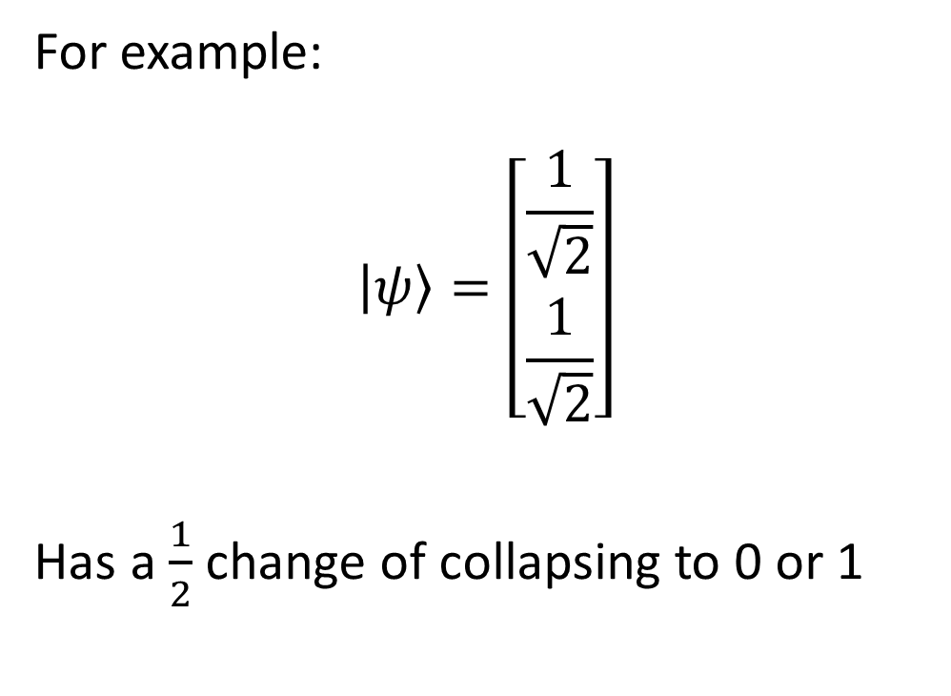
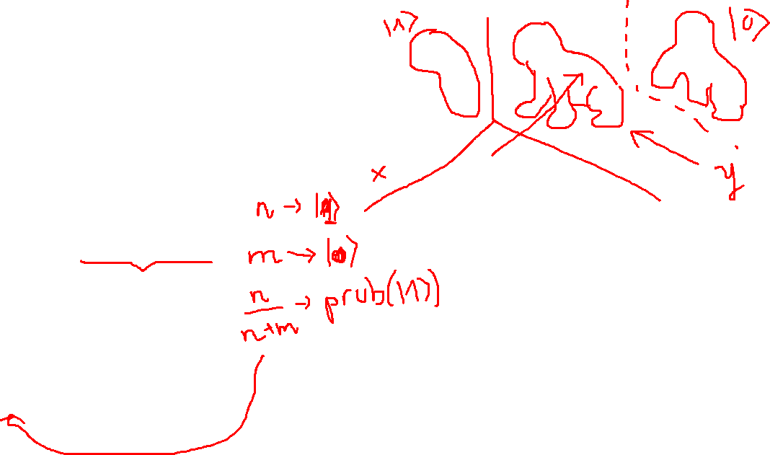
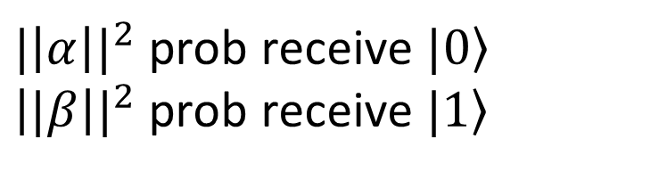
2. Qubit, superposition
$$\left.|Ψ\right\rangle =α\left.|0\right\rangle +β\left.|1\right\rangle$$
For example:
$$\left|ψ\right\rangle =\left[\begin{matrix}\frac{1}{\sqrt{2}} \\ \frac{1}{\sqrt{2}}\end{matrix}\right]$$
Has a $\frac{1}{2}$ change of collapsing to 0 or 1
measure
${|\left|α\right||}^{2}$ prob receive $\left.|0\right\rangle$
${\left||β\right||}^{2}$ prob receive $\left.|1\right\rangle$

Slide 13
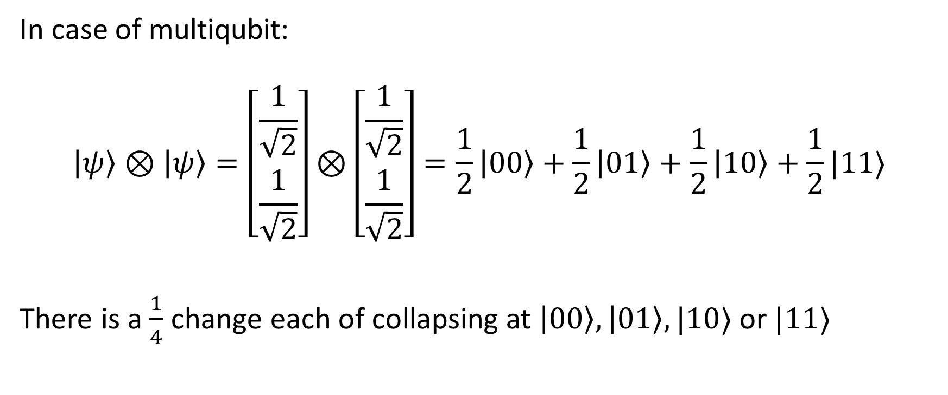
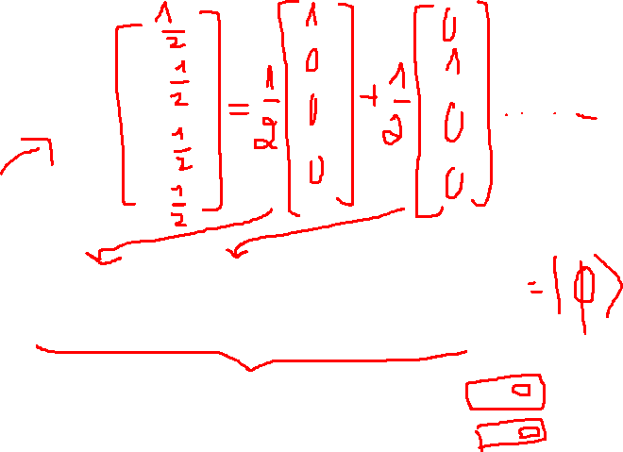
2. Qubit, superposition
In case of multiqubit:
$$\left|ψ\right\rangle ⊗\left|ψ\right\rangle =\left[\begin{matrix}\frac{1}{\sqrt{2}} \\ \frac{1}{\sqrt{2}}\end{matrix}\right]⊗\left[\begin{matrix}\frac{1}{\sqrt{2}} \\ \frac{1}{\sqrt{2}}\end{matrix}\right]=\frac{1}{2}\left|00\right\rangle +\frac{1}{2}\left|01\right\rangle +\frac{1}{2}\left|10\right\rangle +\frac{1}{2}|11⟩$$
There is a $\frac{1}{4}$ change each of collapsing at $\left|00\right\rangle ,\left|01\right\rangle ,|10⟩$ or $|11⟩$

Slide 14
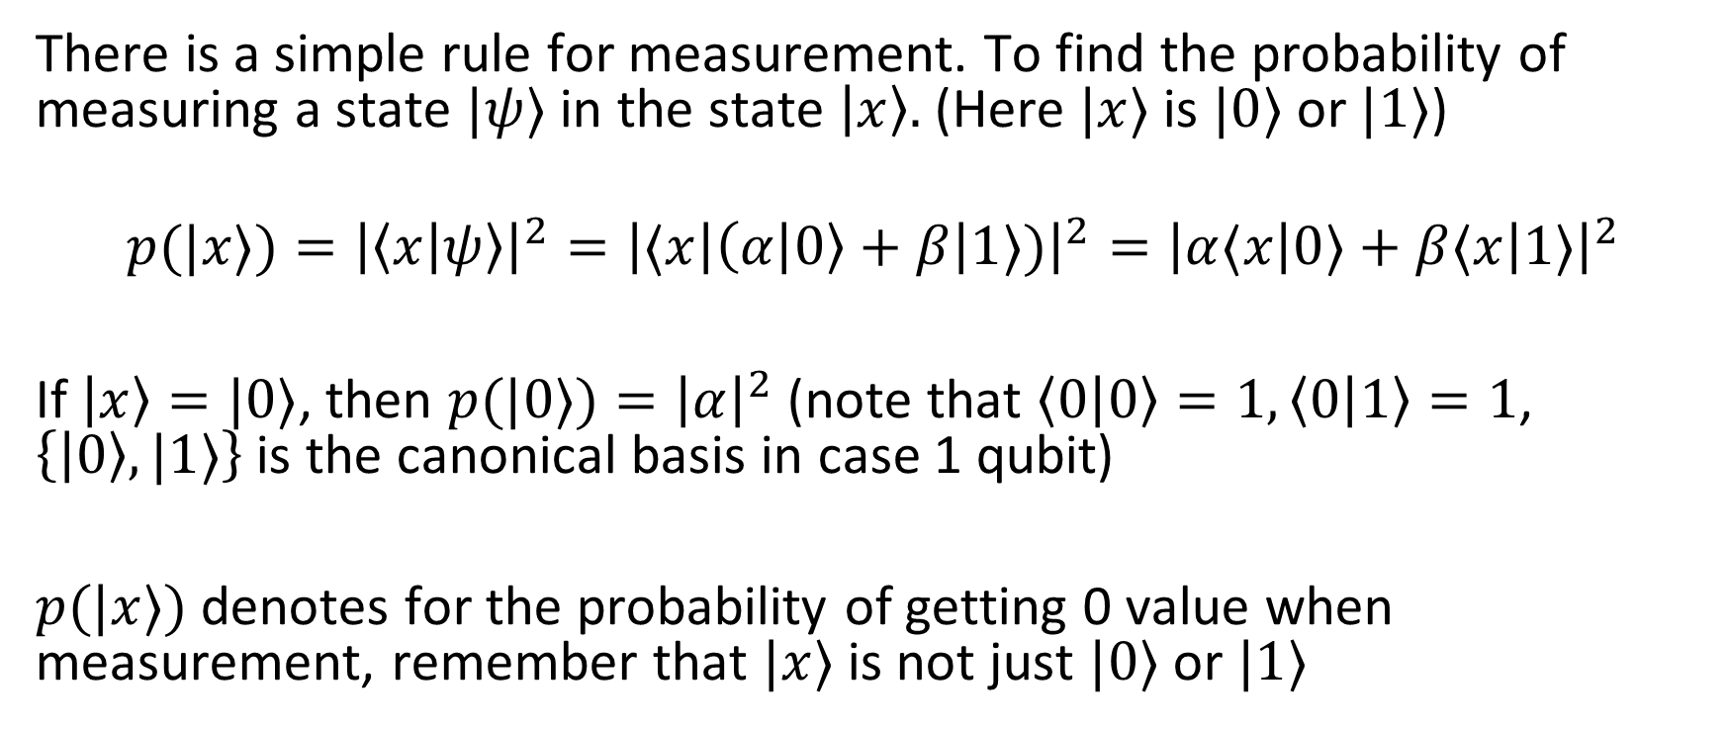
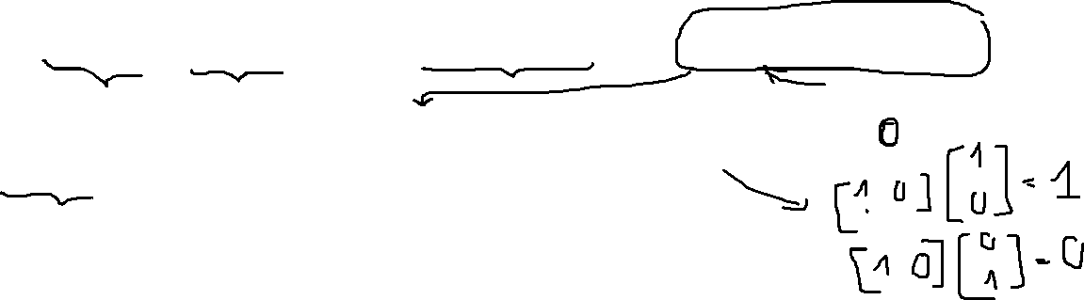
2.1. Rule of measurements
There is a simple rule for measurement. To find the probability of measuring a state $|ψ⟩$ in the state $\left|x\right\rangle .$ (Here $|x⟩$ is $|0⟩$ or $|1⟩$)
$$p(|x⟩)={\left|\left\langle x | ψ\right\rangle \right|}^{2}={\left|⟨x\left|\left(α | 0\right\rangle +β\right|1⟩)\right|}^{2}={\left|α⟨x\left|0⟩+β⟨x\right|1⟩\right|}^{2}$$
If $\left|x\right\rangle =|0⟩$, then $p(|0⟩)={\left|α\right|}^{2}$ (note that $\left\langle 0 | 0\right\rangle =1,\left\langle 0 | 1\right\rangle =1$, $\left\{\left|0\right\rangle ,|1⟩\right\}$ is the canonical basis in case 1 qubit)
$p(|x⟩)$ denotes for the probability of getting 0 value when measurement, remember that $|x⟩$ is not just $|0⟩$ or $|1⟩$

Slide 15
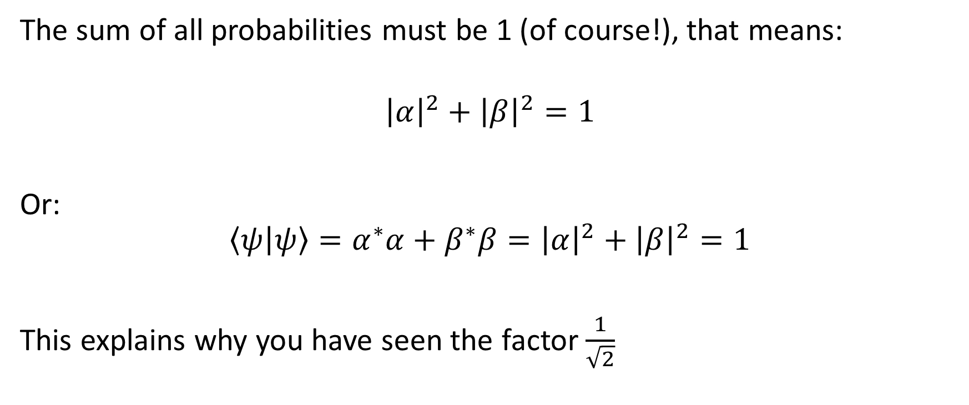
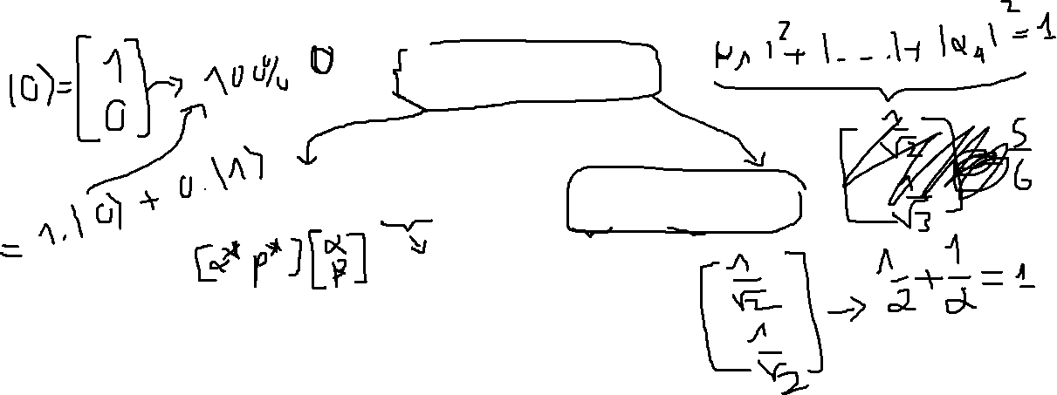
2.2. The Implications of this Rule
The sum of all probabilities must be 1 (of course!), that means:
$${\left|α\right|}^{2}+{\left|β\right|}^{2}=1$$
Or:
$$\left\langle ψ | ψ\right\rangle =α^{∗}α+β^{∗}β={\left|α\right|}^{2}+{\left|β\right|}^{2}=1$$
This explains why you have seen the factor $\frac{1}{\sqrt{2}}$

Slide 16
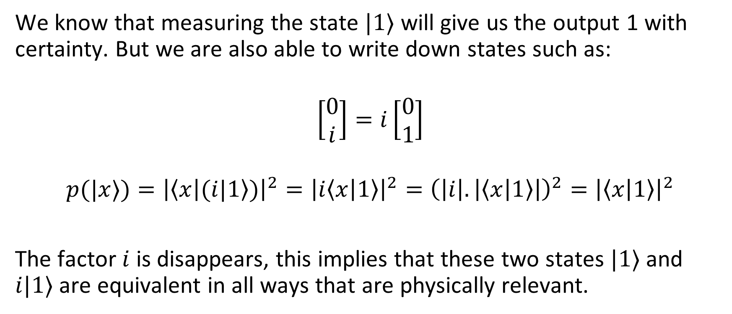
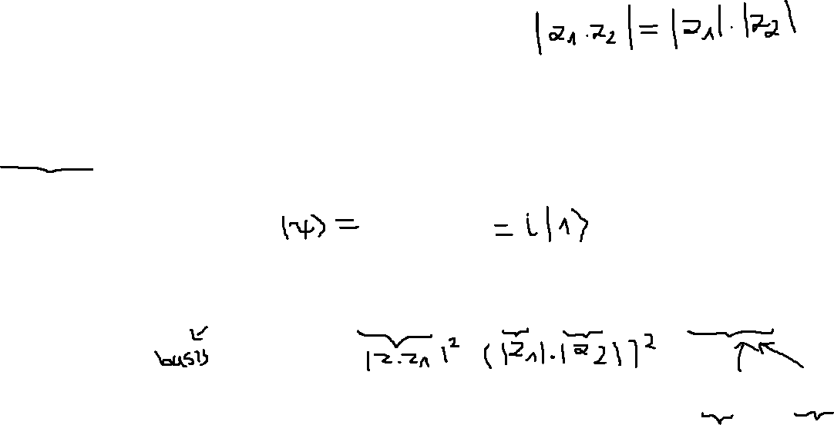
2.3. The global phase
We know that measuring the state $|1⟩$ will give us the output 1 with certainty. But we are also able to write down states such as:
$$\left[\begin{matrix}0 \\ i\end{matrix}\right]=i\left[\begin{matrix}0 \\ 1\end{matrix}\right]$$
$$p(|x⟩)={\left|\left\langle x | (i|1\right\rangle )\right|}^{2}={\left|i\left\langle x | 1\right\rangle \right|}^{2}={\left(\left|i\right|.\left|\left\langle x | 1\right\rangle \right|\right)}^{2}={\left|\left\langle x | 1\right\rangle \right|}^{2}$$
The factor $i$ is disappears, this implies that these two states $|1⟩$ and $i|1⟩$ are equivalent in all ways that are physically relevant.

Slide 17
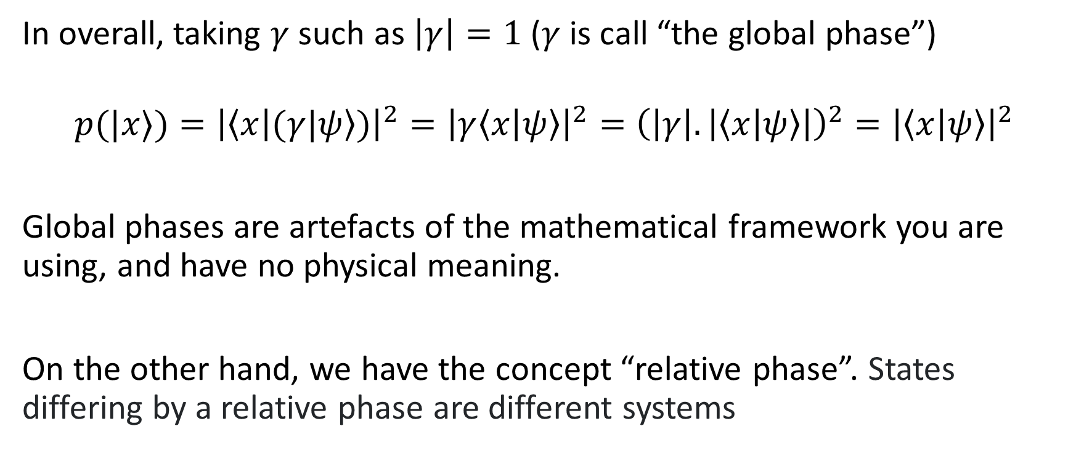
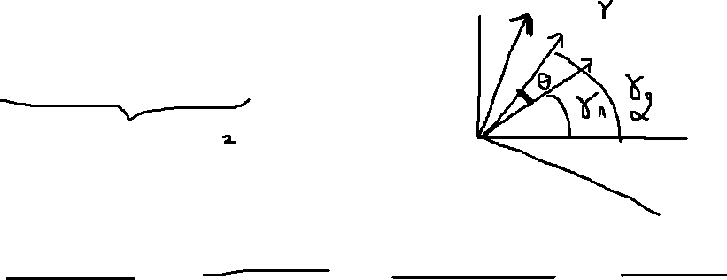
2.3. The global phase
In overall, taking $γ$ such as $\left|γ\right|=1$ ($γ$ is call “the global phase”)
$$p(|x⟩)={\left|\left\langle x | (γ|ψ\right\rangle )\right|}^{2}={\left|γ\left\langle x | ψ\right\rangle \right|}^{2}={\left(\left|γ\right|.\left|\left\langle x | ψ\right\rangle \right|\right)}^{2}={\left|\left\langle x | ψ\right\rangle \right|}^{2}$$
Global phases are artefacts of the mathematical framework you are using, and have no physical meaning.
On the other hand, we have the concept “relative phase”. States differing by a relative phase are different systems

Slide 18
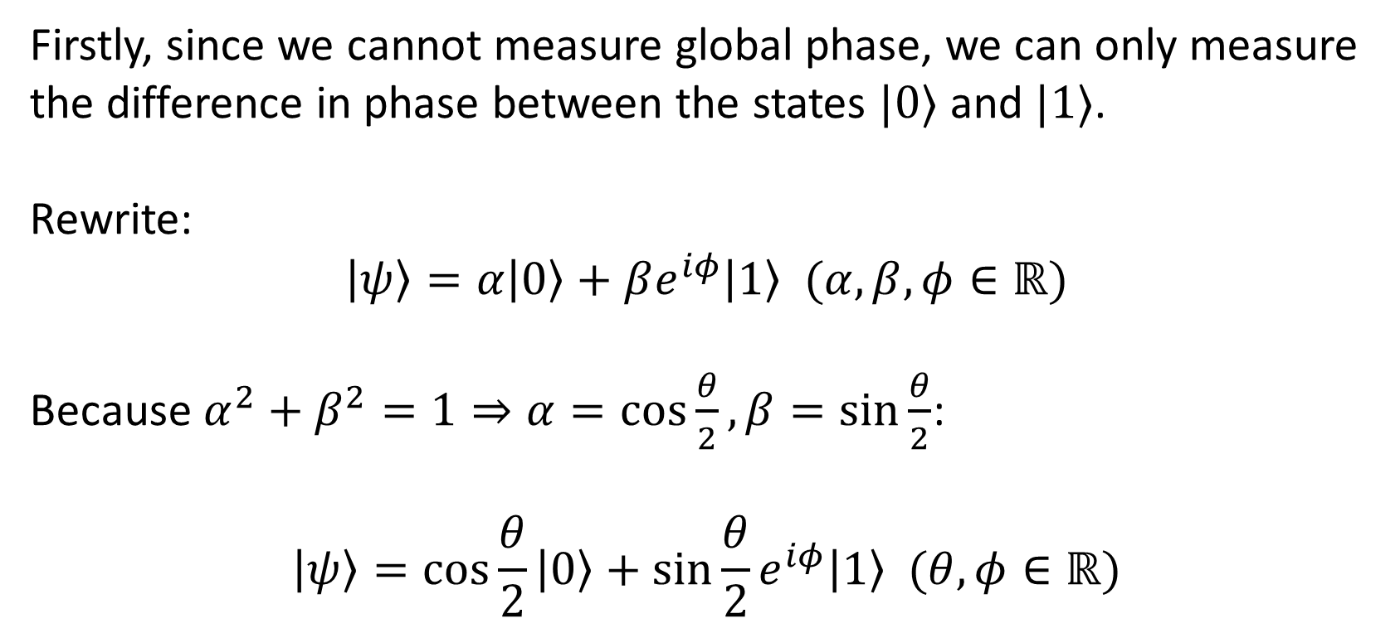
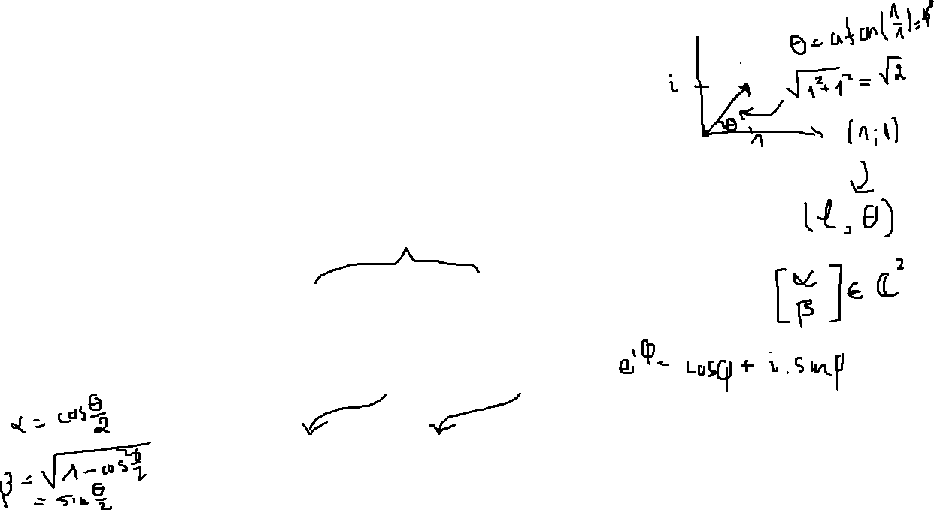
2. 4. Bloch sphere
Firstly, since we cannot measure global phase, we can only measure the difference in phase between the states $|0⟩$ and $|1⟩$.
Rewrite:
$$\left|ψ\right\rangle =α\left|0\right\rangle +βe^{iφ}\left|1\right\rangle (α,β,φ∈ℝ)$$
Because $α^{2}+β^{2}=1⇒α=\cos{\frac{θ}{2}},β=sin{\frac{θ}{2}}$:
$$\left|ψ\right\rangle =\cos{\frac{θ}{2}}\left|0\right\rangle +\sin{\frac{θ}{2}}e^{iφ}\left|1\right\rangle (θ,φ∈ℝ)$$

Slide 19
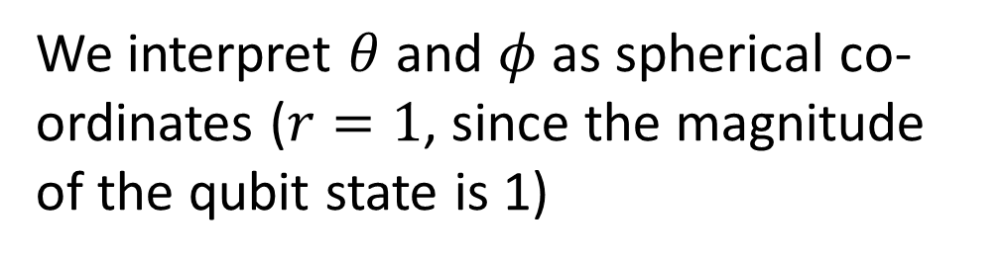

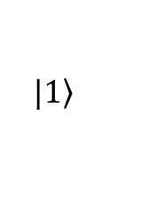


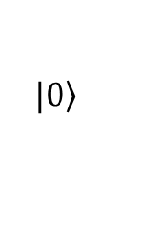




2. 4. Bloch sphere
$$\left.|0\right\rangle$$
$$z$$
$$|ψ⟩$$
We interpret $θ$ and $φ$ as spherical co-ordinates ($r=1$, since the magnitude of the qubit state is 1)
$$θ$$
$$y$$
$$φ$$
$$x$$
$$\left.|1\right\rangle$$

Slide 20




2.5. Operation on qubit
Example:
$$X\left|ψ\right\rangle =\left[\begin{matrix}0 & 1 \\ 1 & 0\end{matrix}\right]\left[\begin{matrix}\frac{1}{2} \\ \frac{3}{\sqrt{2}}\end{matrix}\right]=\left[\begin{matrix}\frac{3}{\sqrt{2}} \\ \frac{1}{2}\end{matrix}\right]$$
Notation:
$$X\left|ψ\right\rangle =|ψ^{′}⟩$$
Operator
State at $t$
State at $t+1$

Slide 21
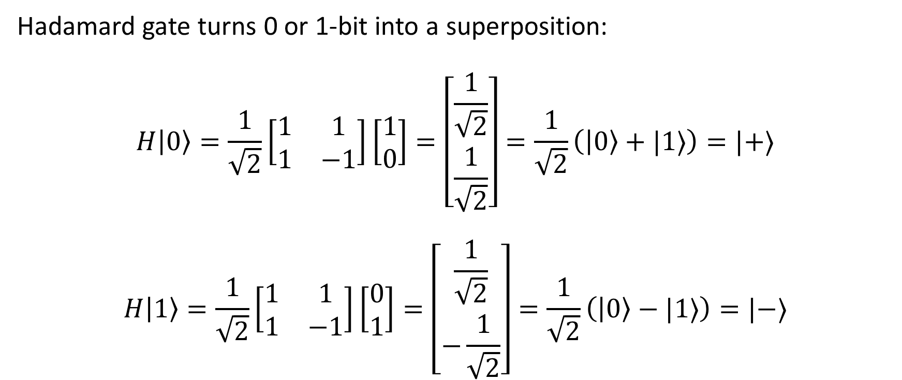
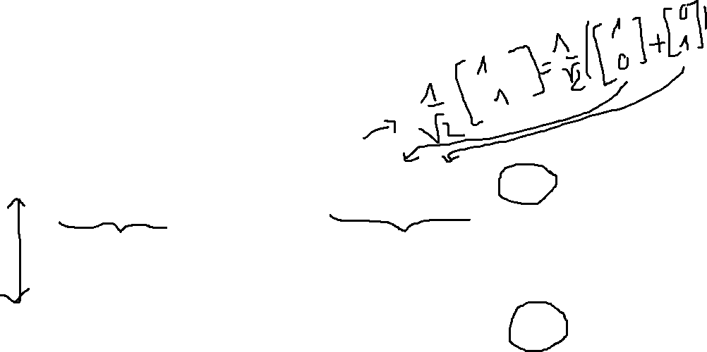
2.5. Important gates: Hadamard gate
Hadamard gate turns 0 or 1-bit into a superposition:
$$H\left|0\right\rangle =\frac{1}{\sqrt{2}}\left[\begin{matrix}1 & 1 \\ 1 & −1\end{matrix}\right]\left[\begin{matrix}1 \\ 0\end{matrix}\right]=\left[\begin{matrix}\frac{1}{\sqrt{2}} \\ \frac{1}{\sqrt{2}}\end{matrix}\right]=\frac{1}{\sqrt{2}}\left(\left|0\right\rangle +|1⟩\right)=|+⟩$$
$$H\left|1\right\rangle =\frac{1}{\sqrt{2}}\left[\begin{matrix}1 & 1 \\ 1 & −1\end{matrix}\right]\left[\begin{matrix}0 \\ 1\end{matrix}\right]=\left[\begin{matrix}\frac{1}{\sqrt{2}} \\ −\frac{1}{\sqrt{2}}\end{matrix}\right]=\frac{1}{\sqrt{2}}\left(\left|0\right\rangle −|1⟩\right)=|−⟩$$

Slide 22
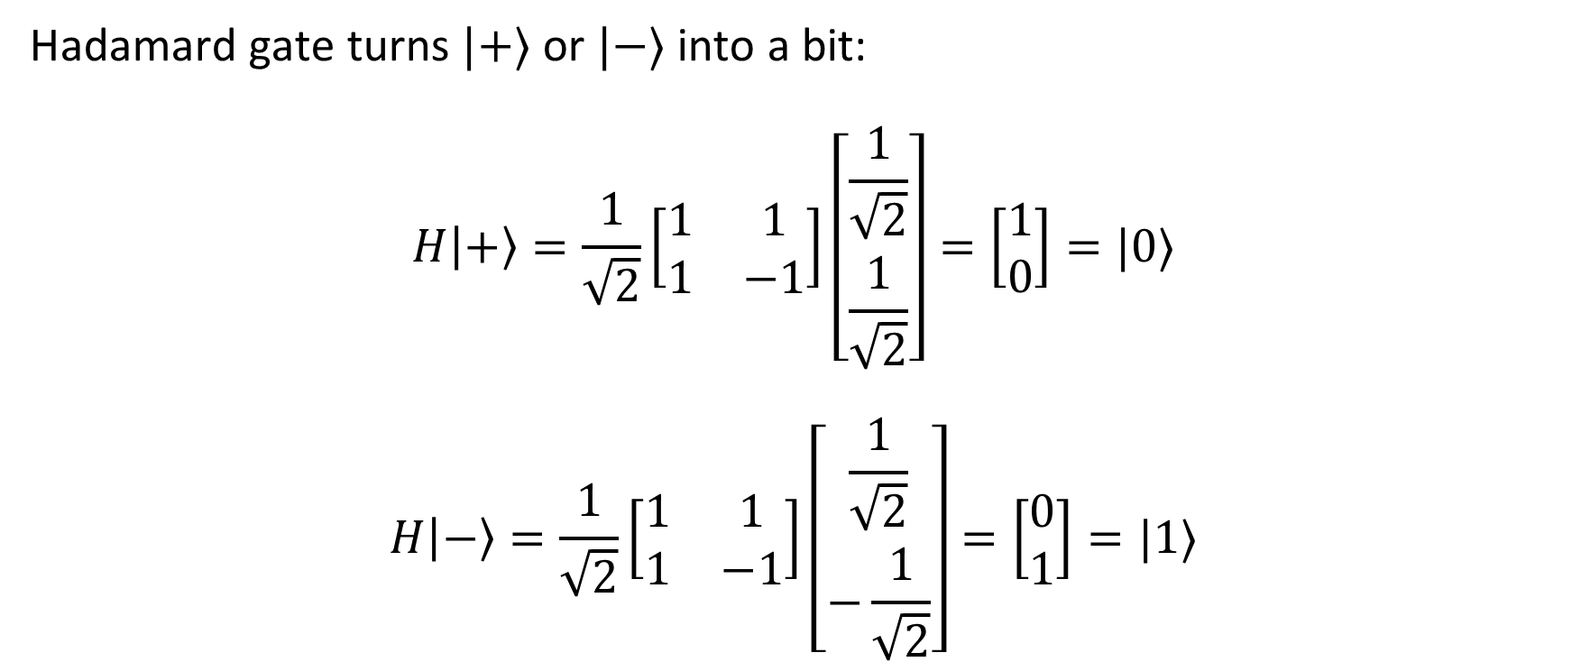
2.5. Important gates: Hadamard gate
Hadamard gate turns $|+⟩$ or $|−⟩$ into a bit:
$$H\left|+\right\rangle =\frac{1}{\sqrt{2}}\left[\begin{matrix}1 & 1 \\ 1 & −1\end{matrix}\right]\left[\begin{matrix}\frac{1}{\sqrt{2}} \\ \frac{1}{\sqrt{2}}\end{matrix}\right]=\left[\begin{matrix}1 \\ 0\end{matrix}\right]=|0⟩$$
$$H\left|−\right\rangle =\frac{1}{\sqrt{2}}\left[\begin{matrix}1 & 1 \\ 1 & −1\end{matrix}\right]\left[\begin{matrix}\frac{1}{\sqrt{2}} \\ −\frac{1}{\sqrt{2}}\end{matrix}\right]=\left[\begin{matrix}0 \\ 1\end{matrix}\right]=|1⟩$$

Slide 23

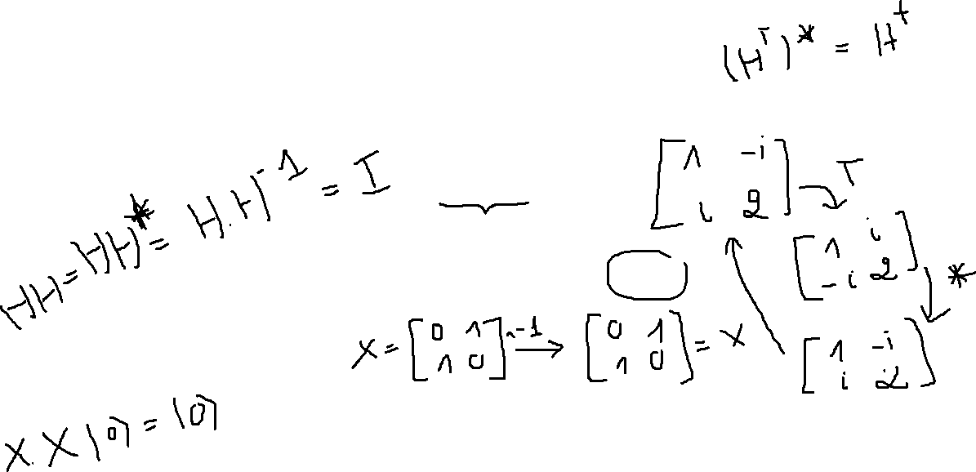
2.5. Quantum gate
All quantum gates are Hermitian (some are Unitary)
$$H=H^{†}$$
$H^{†}H=HH^{†}$ and $H^{†}=H^{−1}$
That cause:
$$HH\left|ψ\right\rangle =HH^{−1}\left|ψ\right\rangle =I\left|ψ\right\rangle =|ψ⟩$$

Slide 24

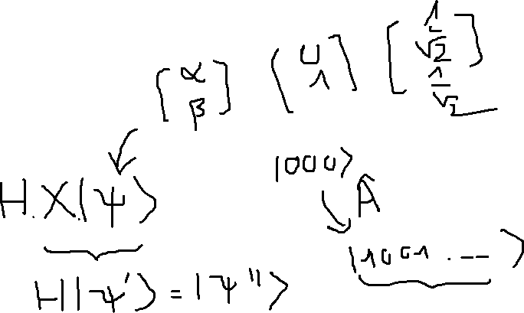
2.6. Pratical
Is $HZH$ equivalent with $X$ gate?

